Slide 1
CROP PRODUCTION AND MANAGEMENT
Predicting Best Crop in Andhra Pradesh - India

Slide 2
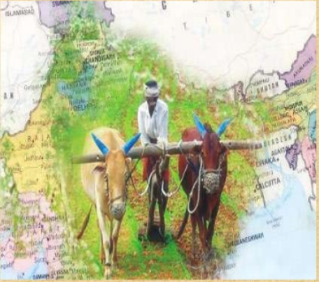
Agriculture
Growing plants and receiving animals for food , clothing, and other useful products is called agriculture.

Slide 3
Description
Crops - Plants of same kind grown on a large scale for food, clothing, etc., are called crops.
KHARIF CROPS - They are generally planted in June and harvested in October. Rice, maize, cotton and ground nuts are examples of kharif
RABI CROPS - They are generally planted in November and harvested in April. Wheat, barley ,pea and gram are examples of rabi crops.
Agricultural practices:-
1. Soil Preparation (Ploughing, Leveling, Applying fertilizers
2. Selection and sowing of seeds
3. Irrigation (watering of crops)
4. Weeding and crop protection
5. Harvesting and storage
Selecting good-quality, healthy seeds is the next important of crop production.

Slide 4
Data acquisition and cleaning
Crop dataset from https://data.gov.in/resources/district-wise-season-wise-crop-production-statistics-1997
The data refers to district wise, crop wise, season wise and year wise data on crop covered area and production (1997-2012)
The data is being used to study and analyze crop production, production contribution to district/State/country, Agro-climatic zone wise performance, and high yield production order for crops, crop growing pattern and diversification.
One state will be analyzed in this project: Andhra Pradesh
Data set for the Andhra Pradesh contains a total of 9628 records with 7 features for different districts.
Using Foursquare API we will find all geographical coordinates of each State.

Slide 5
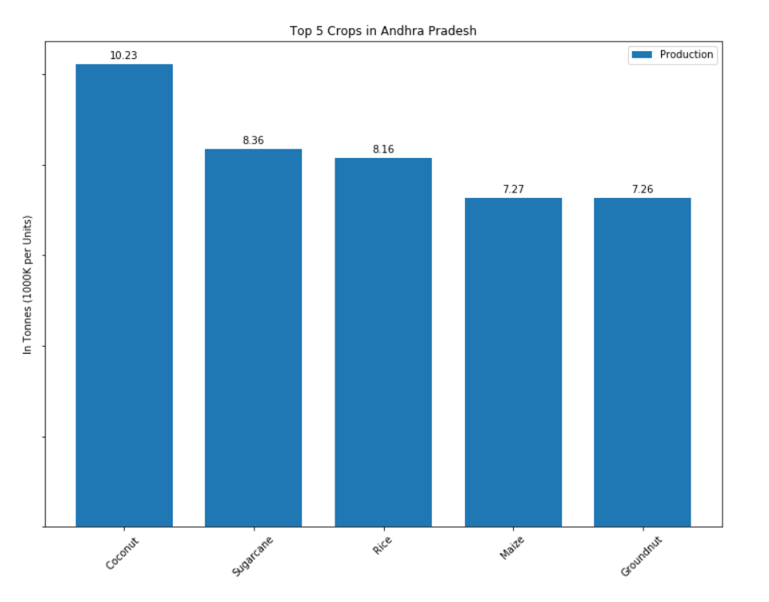
Analysis Results
To 5 Crops in AP

Slide 6
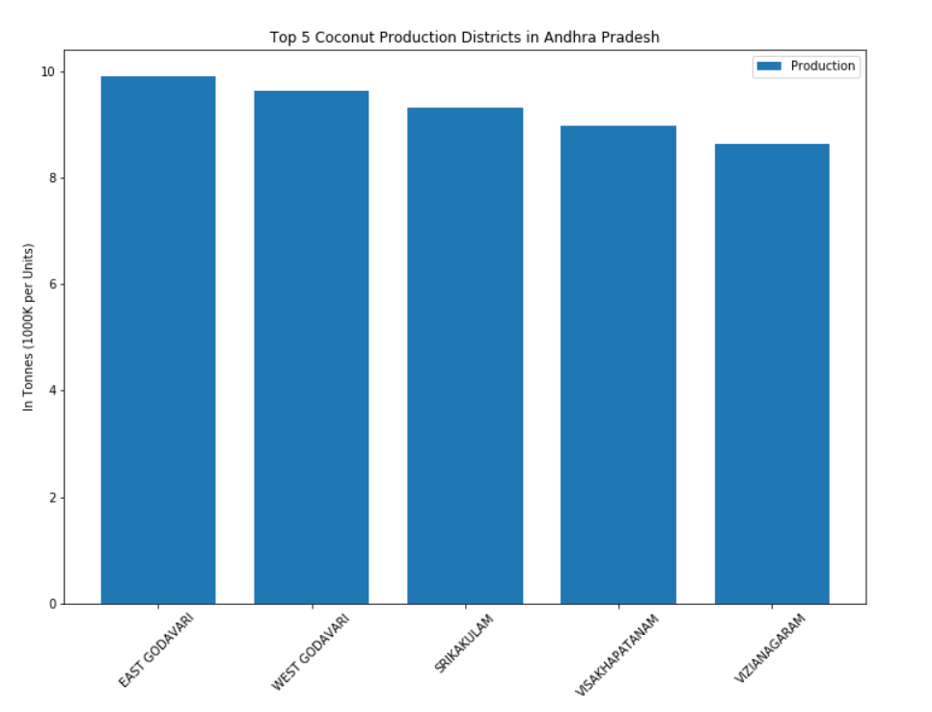
Analysis Results1
Top 5 Districts in Coconut production in AP

Slide 7
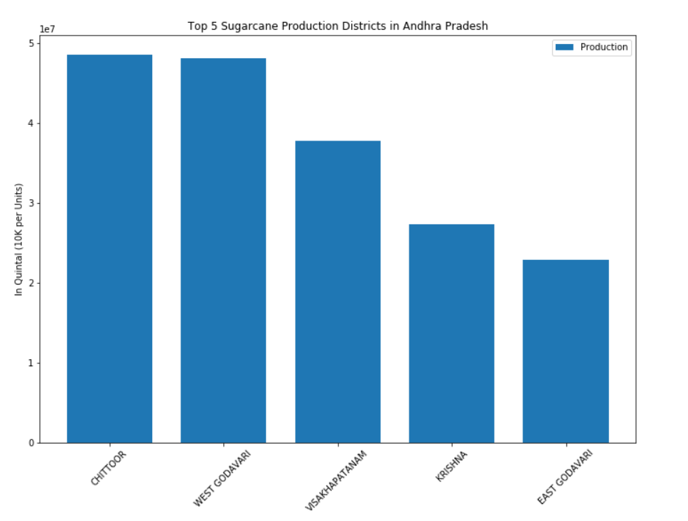
Analysis Results 2
Top 5 Districts in Sugarcane production in AP

Slide 8
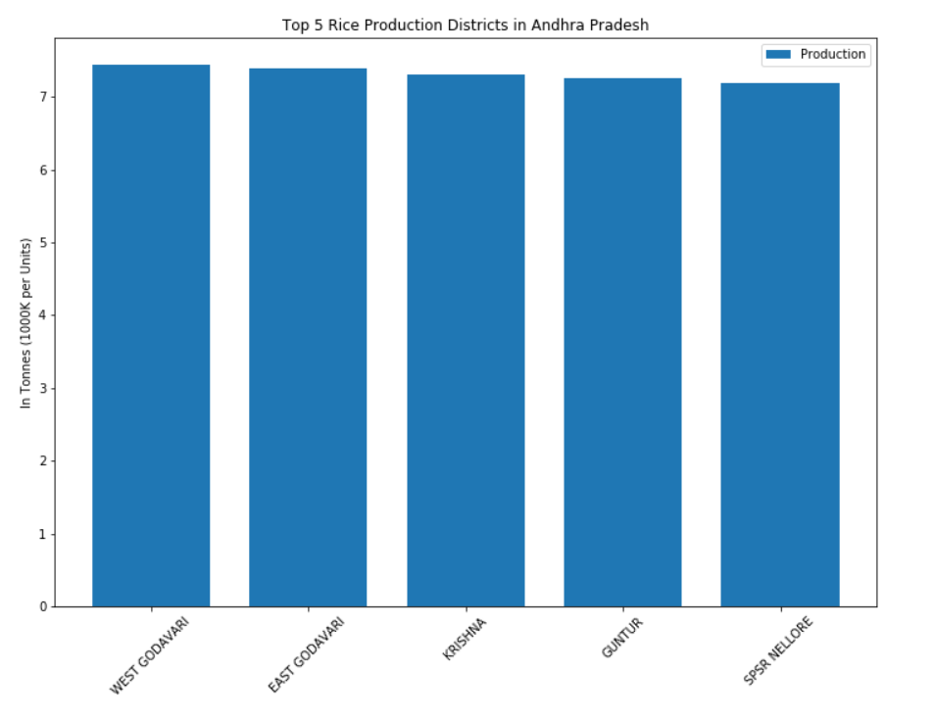
Analysis Results 3
Top 5 Districts in Rice production in AP

Slide 9
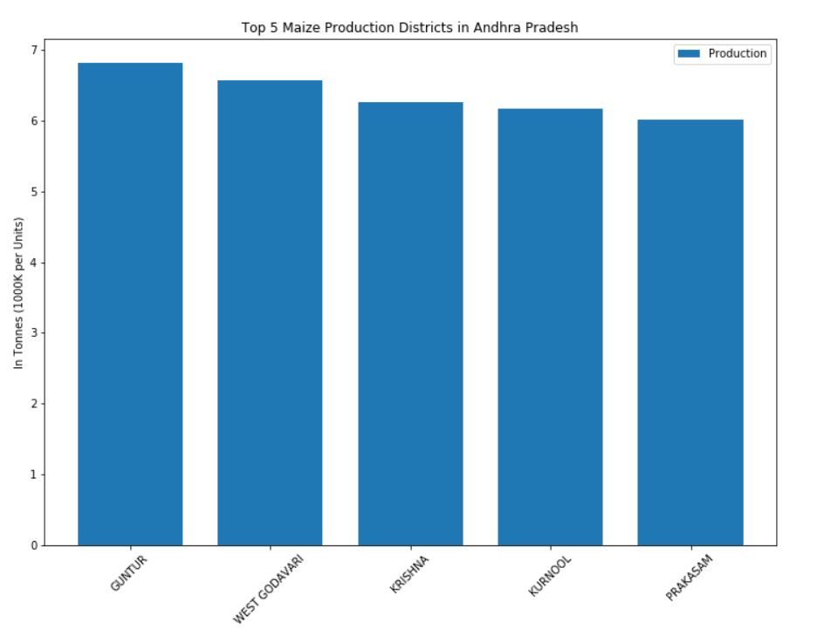
Analysis Results 4
Top 5 Districts in Maize production in AP

Slide 10
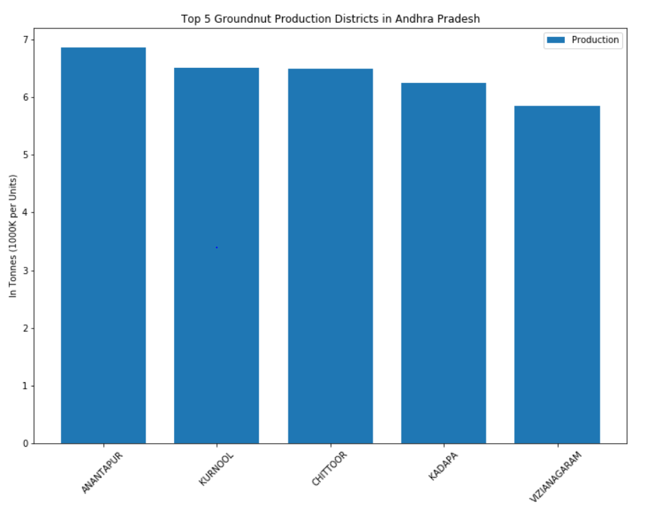
Analysis Results 5
Top 5 Districts in Groundnut production in AP

Slide 11
Conclusion and future directions
Built useful models to predict best suitable crop in selected location.
Accuracy of the models has room for improvement.
Capture more data for the on monthly/season bases from each district of each state in India.
Ideas include:
○ Weather forecast data (wind speed, weather condition, etc.)
○ Soil test data (what kind of minerals, fertilizers, etc.)

